Slide 1

Committed to meeting the needs of today and the challenges of tomorrow.

Slide 2

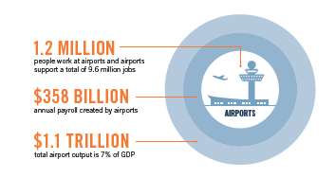
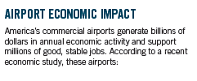
America’s Airports: Engines of Economic Growth

Slide 3


Passenger Facility Charge (PFC)
Local Investment
Competition
Unmet Needs

Slide 4

Local Investment in Local Communities
LOCAL, LOCAL, LOCAL
  PFCs strengthen local control over investment decisions based on a community’s needs
  Allow airports to upgrade facilities and attract new air service for their communities
  Projects and funding plans developed in transparent, public process
SECURITY, SAFETY, SUSTAINABILITY
  Promotes airport modernization
  Finances critical infrastructure projects
  Encourages private, free-market innovation

Slide 5
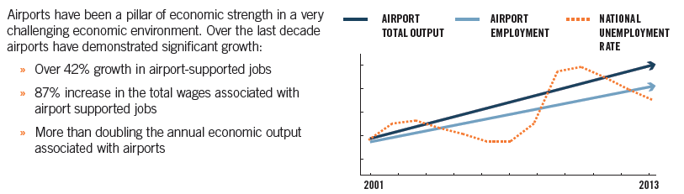
Community Benefits
-

Slide 6

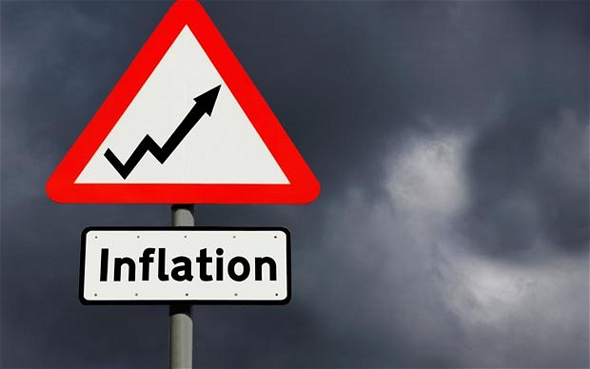
It’s Time to Modernize the PFC
Current $4.50 Cap Is Outdated
  Last adjusted in 2000
  Purchasing power eroded by 50%
Adjust Cap to $8.50 and Index for Inflation
  Restores purchasing power to airports
  No additional cost to the federal government
  Promotes local choices to invest in critical infrastructure projects

Slide 7
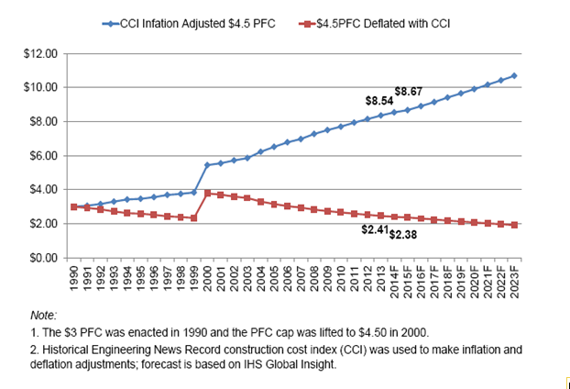
PFC Modernization Long Overdue

Slide 8

PFCs Spur Competition
New Investments
New Carriers
Increased Competition
Lower Fares and More Choices for Passengers

Slide 9

Unmet Needs at Airports
Infrastructure Modernization
Airports of all sizes need over $15.14B a year in infrastructure improvements
Debt Capacity
Airports have reached their debt capacity and can no longer finance new projects, forcing them to delay the completion of existing ones
Increasing Costs
Delayed and canceled improvement projects increase costs and delay benefits to passengers
This is more than the $6.2B airports received from both PFCs and AIP last year
Important for airports of all sizes

Slide 10
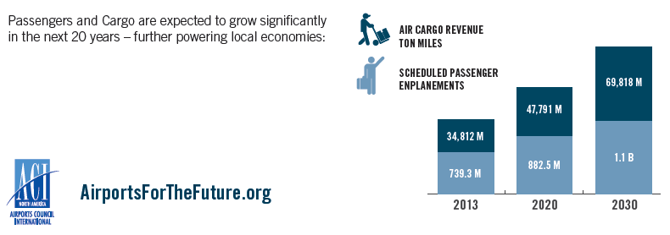
Airport Operations
Taking-Off in the Future

Slide 11
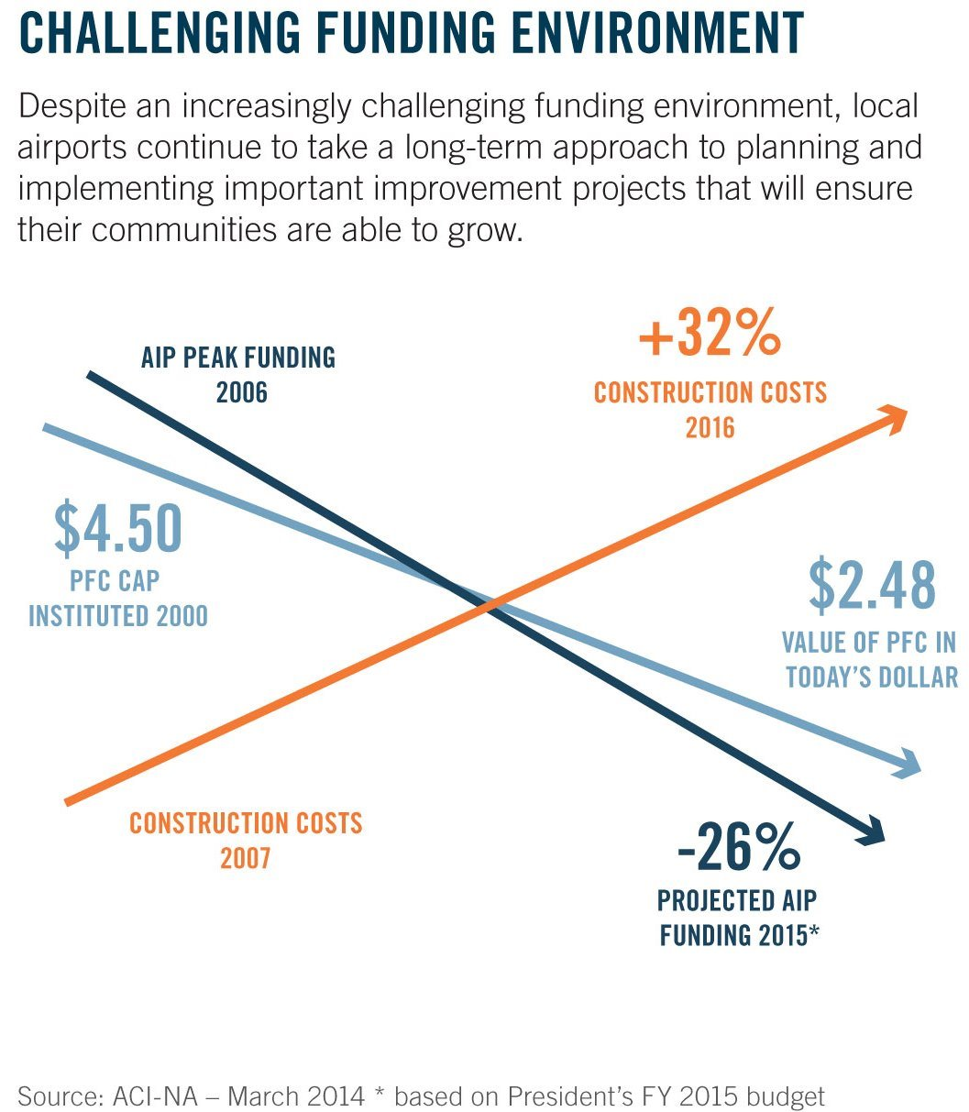
PFC Is Best Funding Option

Slide 12
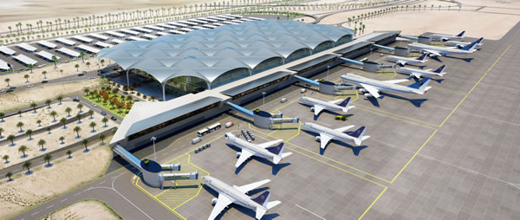
Summary
Strengthen local control over local investment decisions
Airport investment promotes competition
Airports have tremendous unmet needs

Slide 13


Are you on board?
#AirportsUnited

